Slide 1

KYOTO UNIVERSITY
URBAN MANAGEMENT DEPARTMENT
Benchmarking - An Effective Approach to Improve Vietnamese Pavement Management System
Supervisors:
Prof. Kiyoshi Kobayashi (Kyoto University)
Asso. Prof. Kiyoyuki Kaito (Osaka University)
Presenter: Le Thanh Nam (Kyoto University)
November, 23th 2007

Slide 2
CONTENTS
INTRODUCTION
FRAMEWORK
MIXTURE HAZARD MODEL AND BENCHMARKING
EMPIRICAL APPLICATION
LIFE CYCLE COST AND BENCHMARKING
CONCLUSION

Slide 3
INTRODUCTION
Problems
Inhomogeneous condition of PMS (borrowed technologies, variety in practice)
Lack of supportive tools for optimal .
Objectives
To benchmark the deteriorate progress, life cycle cost of different roads, groups of road in regard to concerns of technology by applying Mixture Markov Model and Life cycle cost analysis.
To propose optimal pavement surface technology, maintenance strategy for Vietnamese PMS

Slide 4
BENCHMARKING APPROACH
INTERNAL BM
Hazard models
Repair mechanism
Economic performance evaluation
EXTERNAL BM
Hazard models
Repair mechanism
Economic performance evaluation
Vietnam
Japan
SUPERIOR TECHNOLOGIES, MAINTENANCE STRATEGIES

Slide 5





BENCHMARKING AND MIXTURE HAZARD MODEL
Heterogeneity
Sampling taken from a mixture of distribution which varies between sub-populations
Sub-populations (road or groups of road in similarity) bear different impacts, thus their hazard rates distributed differently.
Mixing mechanism
time interval
covariate vector
heterogeneity
number of groups
Mixture model for Benchmarking

Slide 6

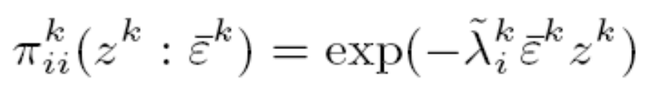
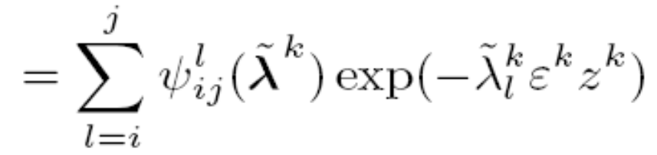
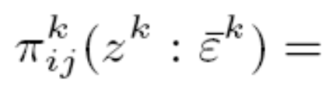
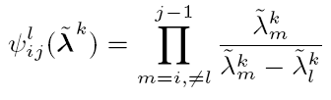
MIXTURE HAZARD MODEL
(1)
Transition probability with heterogeneity
(2)
(3)
(4)

Slide 7
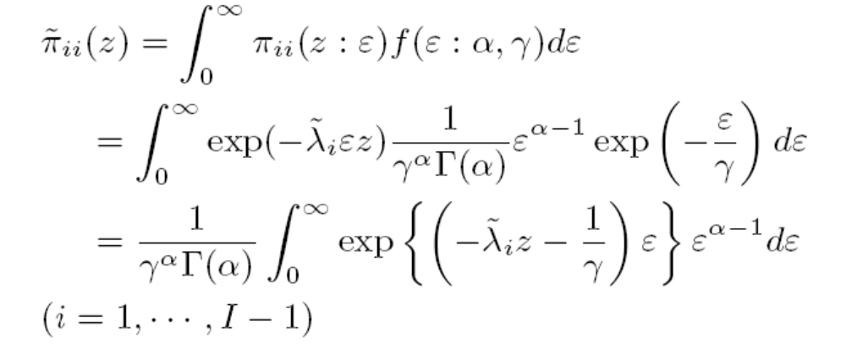
MIXTURE HAZARD MODEL
Estimation approach

Slide 8
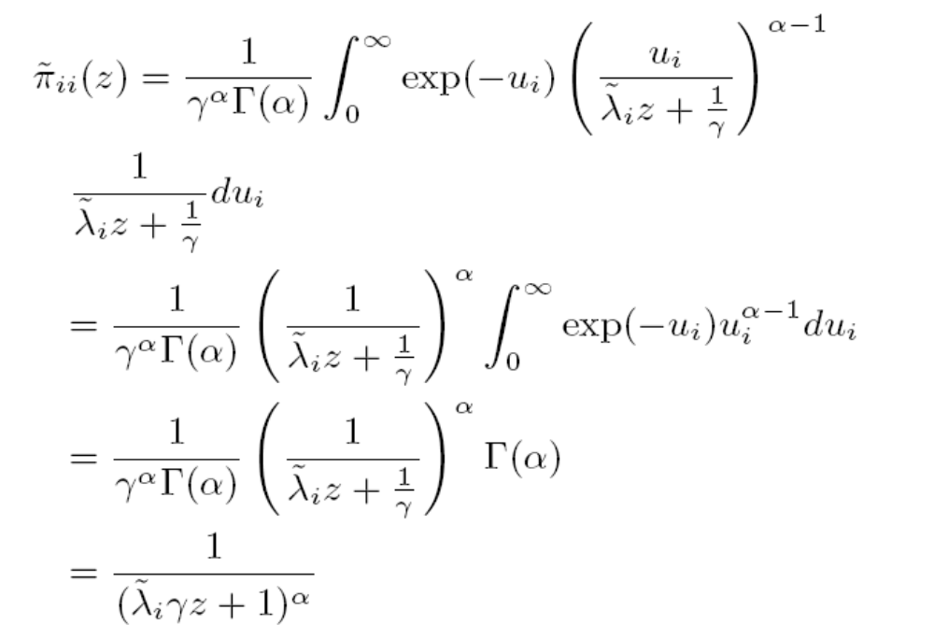
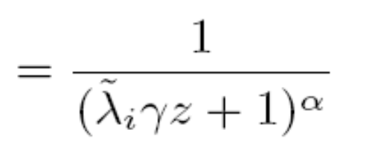
MIXTURE HAZARD MODEL
Estimation approach

Slide 9
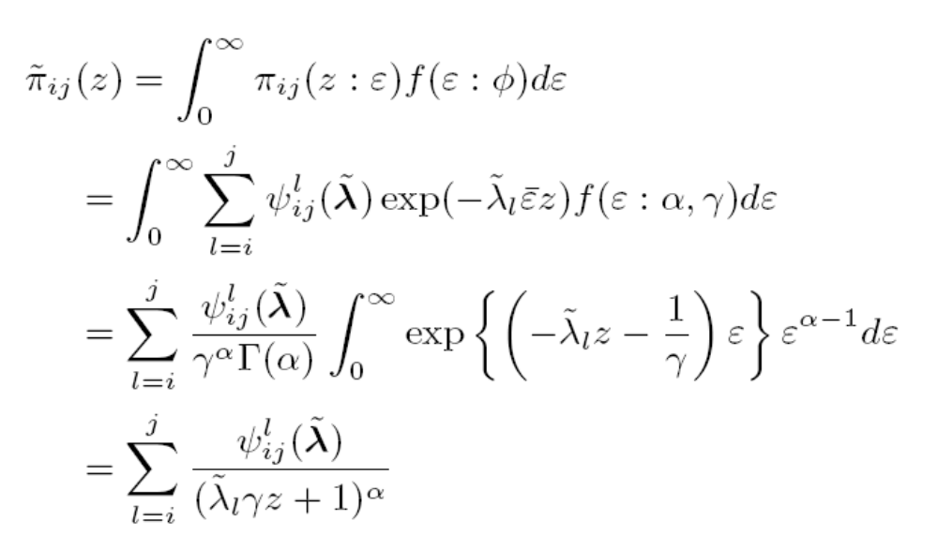
MIXTURE HAZARD MODEL
Estimation approach

Slide 10



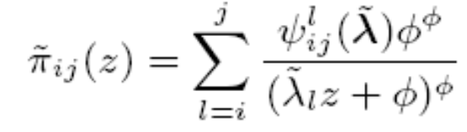
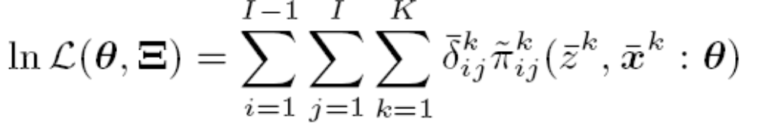
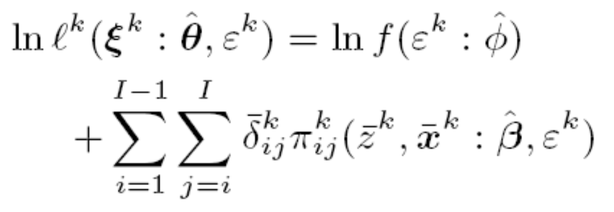
MIXTURE HAZARD MODEL
Estimation approach
Heterogeneity Hazard rate are distributed to average hazard rate . In this preposition, Gamma distribution of mean 1 and standard variance of are assumed
Step 1
Step 2

Slide 11
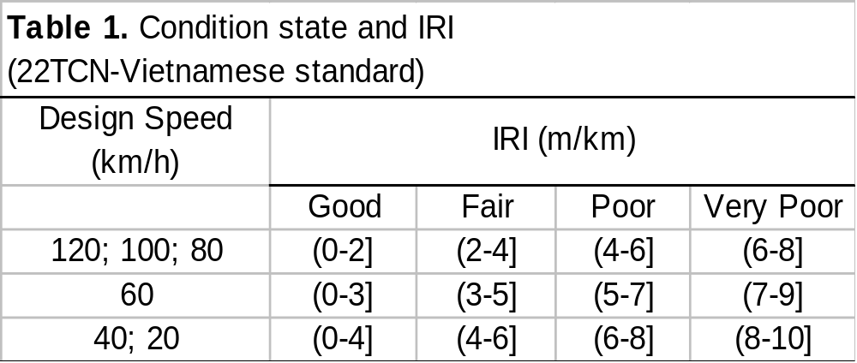
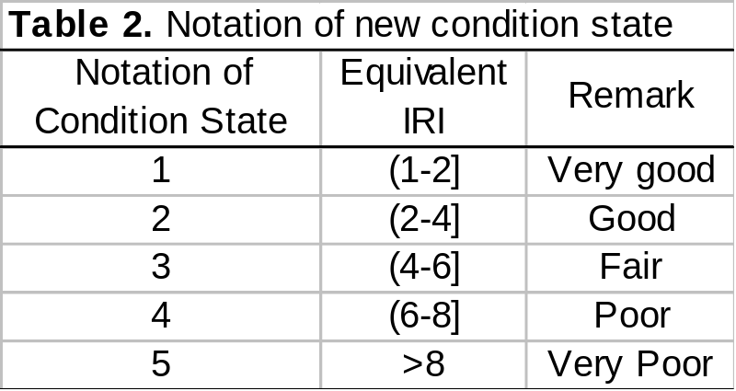
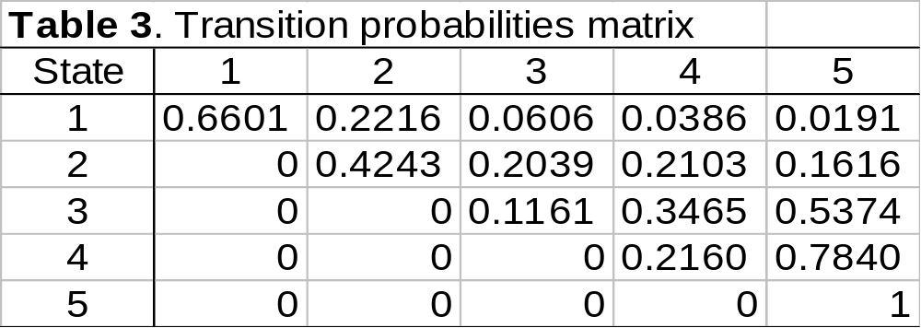
EMPIRICAL EXAMPLE
Number of sections: 1903
Inspection time: 2001 & 2004
Covariate vectors: x
(traffic volume & road thickness)

Slide 12
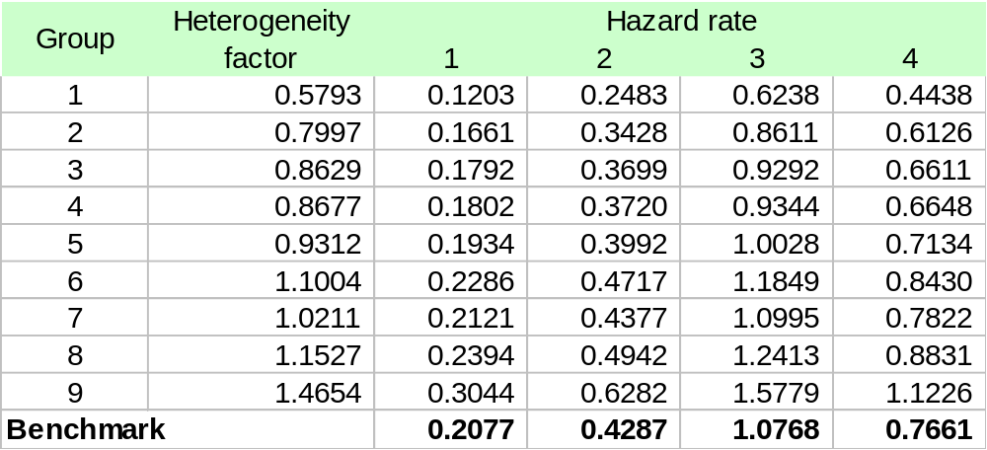
EMPIRICAL EXAMPLE (cont.)
Table 4: Heterogeneity and hazard rate

Slide 13
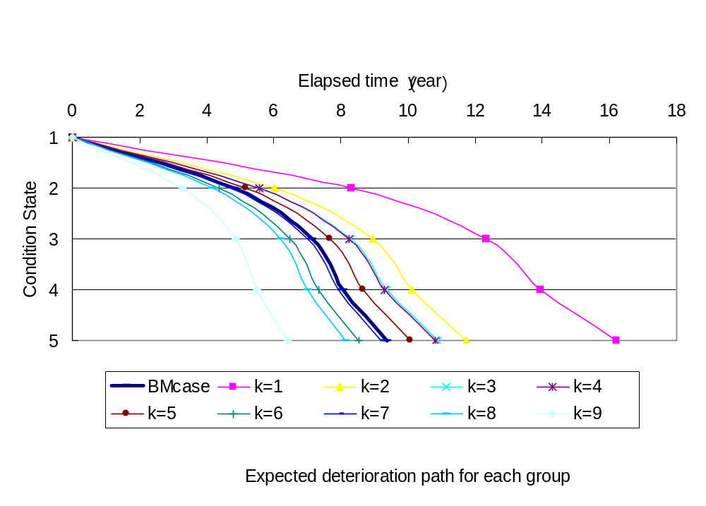
EMPIRICAL EXAMPLE (cont.)
Life cycle cost analysis for economic performance evaluation

Slide 14
LIFE CYCLE COST ANALYSIS
Repair mechanism and Markov decision process
Repair action d change the condition of state from worse to good
Several repair actions D=(d1,d2,d3…) can be applied to a condition state
Repairing cost is required
Upon repair action, transition probability will change and to be followed by Markov decision process
Economic performance evaluation
Aiming to select the repair actions, maintenance strategies, which offer minimum accumulative cost over the life cycle of roads

Slide 15
CONCLUSION
Road administrator can differentiate hazard rate of each road, or group of road in the entire road network system. Thus, deliberately focus can be drawn on roads with faster deterioration. In the sequel, further findings on the main cause to deterioration can be learned.
Best design practices, standards, technologies can be archived from research application in Vietnam. Thus, facilitating the formation of standards in pavement design, specification, and maintenance strategies

Slide 16
KYOTO UNIVERSITY
URBAN MANAGEMENT DEPARTMENT
THANK YOU VERY MUCH
ありがとう ございます

